Slide 1


AI as Friend
By
Shah Rukh Khan (10)
Awais Ahmad Khan (9)

Slide 2
Introduction / Motivation
Developing a user friendly chat bot.
Developing necessary skills for NLP and Data analysis with some practical applications.
Combining NLP concepts with AI.
Increasing some basic knowledge of Neural network models and their applications.

Slide 3



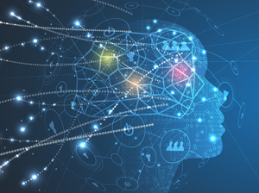
Types of Chatbots
Retrieval based
Neural Network Based

Slide 4
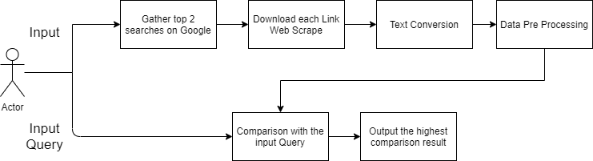
Retrival Based

Slide 5
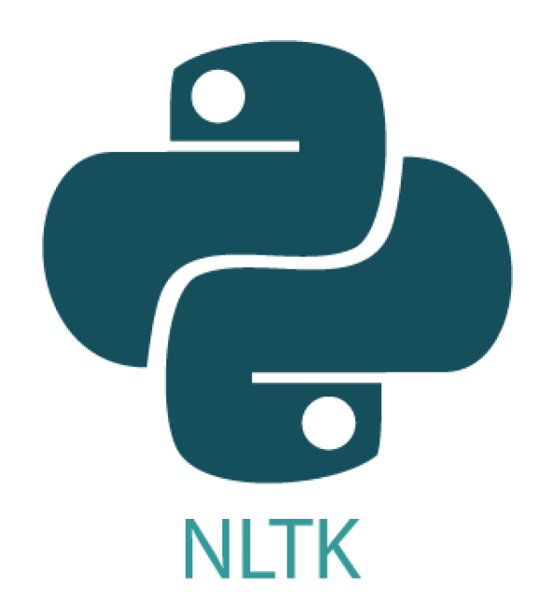

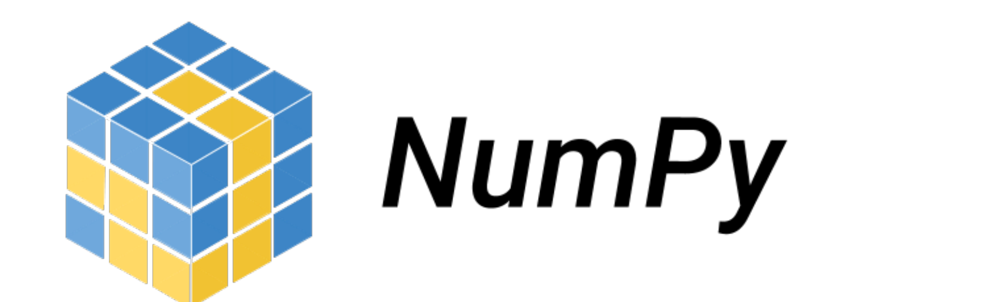
Libraries Used
Newspaper3k
Sklearn
Nltk
Numpy
googlesearch

Slide 6
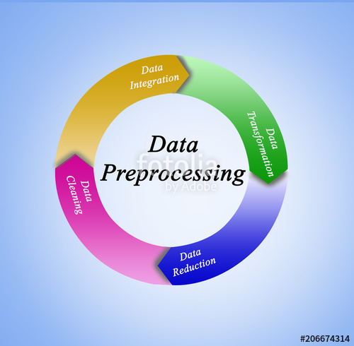
Data Preporcessing
Create corpus (Append each article from search)
Remove punctuations
TFIDF vectorize
Cosine Similarity with the list
Arrange in descending order
Grab the last sentence from the list (Maximum cosine similarity)

Slide 7
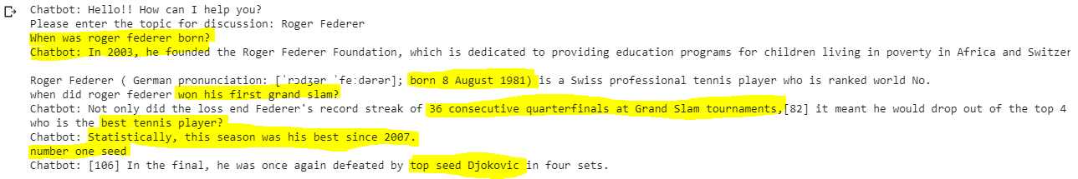
Results

Slide 8
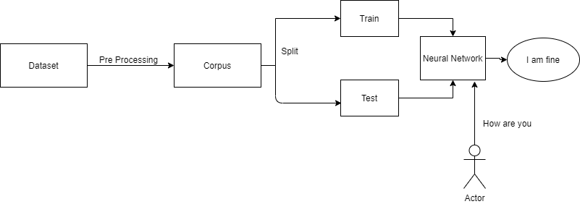
Neural Network Based Chatbot

Slide 9



Libraries
Pandas
Tensorflow
Numpy
Sqllite3

Slide 10
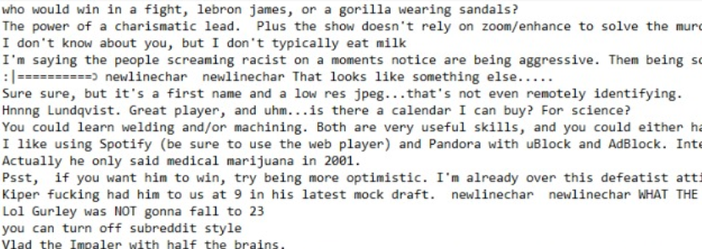
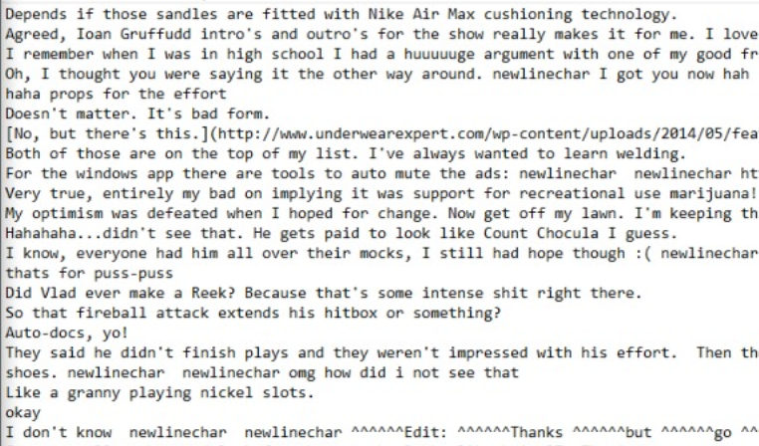
Data Processing

Slide 11
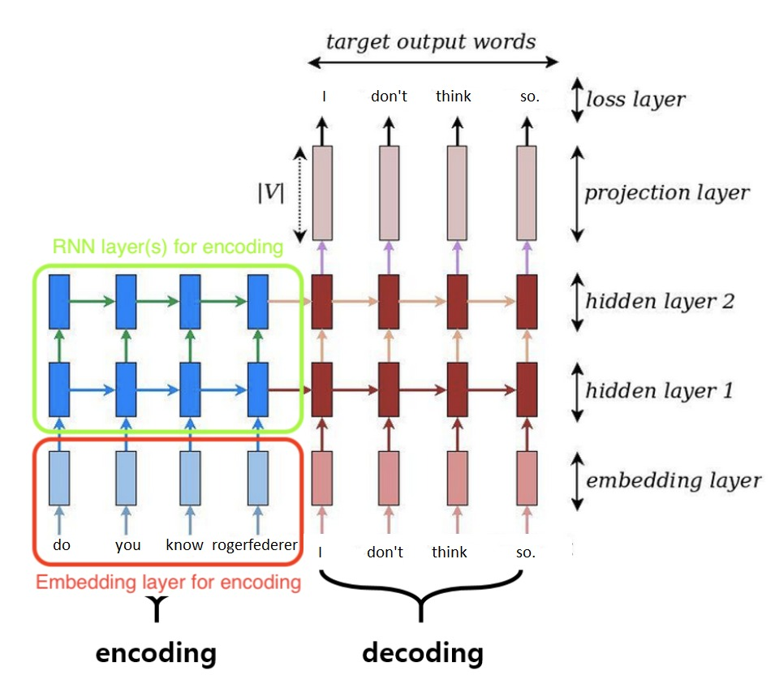
Sequence to Sequence Architecture

Slide 12
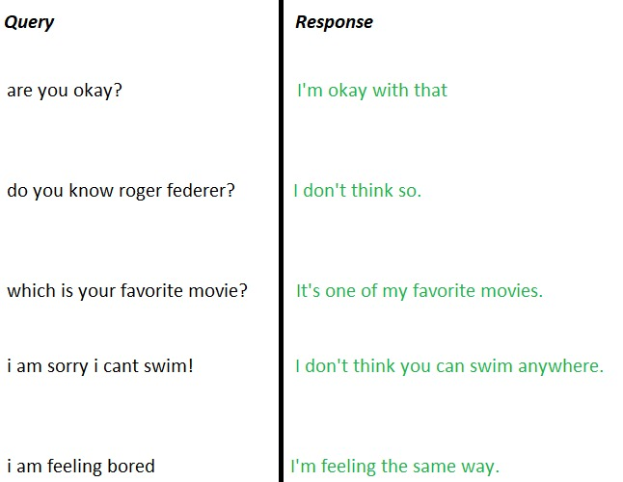
Results

Slide 13
Datasets
Reddit dataset (2007-2015)
WikiQA corpus
Semantic web interest group

Slide 14
Issues
Retrieval Based
Data is limited (2 urls). Increasing the data not necessarily produce better results.
Retrieving takes more time so time taken by pre processing also increases.
Answers are constant for same search results.

Slide 15
Issues
Neural Network Based
Data preparation for training (Each dataset is different)
Training takes a huge time (weeks for data of 2 years)
Ambiguity due to data clipping.
No necessarily produce good results if we increase the data.

Slide 16
Future Objectives
Introduce threading in Retrieval based chatbot to reduce time.
Develop facebook conversation based chat for a specific person. (Scraping conversations for preparing dataset)

Slide 17
Contributions
Awais Ahmad Khan
Developed extraction from web for retrieval based chatbot
Pre processing of data for neural network chatbot
Shah Rukh Khan
Pre Processing of data for retrieval based chatbot
Training of neural Network

Slide 18
References
https://hackernoon.com/deep-learning-chatbot-everything-you-need-to-know-r11jm30bc
https://www.tensorflow.org/addons/tutorials/networks_seq2seq_nmt
https://kavita-ganesan.com/tfidftransformer-tfidfvectorizer-usage-differences/

